Slide 1
3D Image Segmentation and Quantification of Lysosomes
2nd meeting 08/09/2025

Slide 2
PROGRESS
I have been working with the Napari framework based on python to obtain a topographic map where the separation between different lysosomes can be better seen.

Slide 3
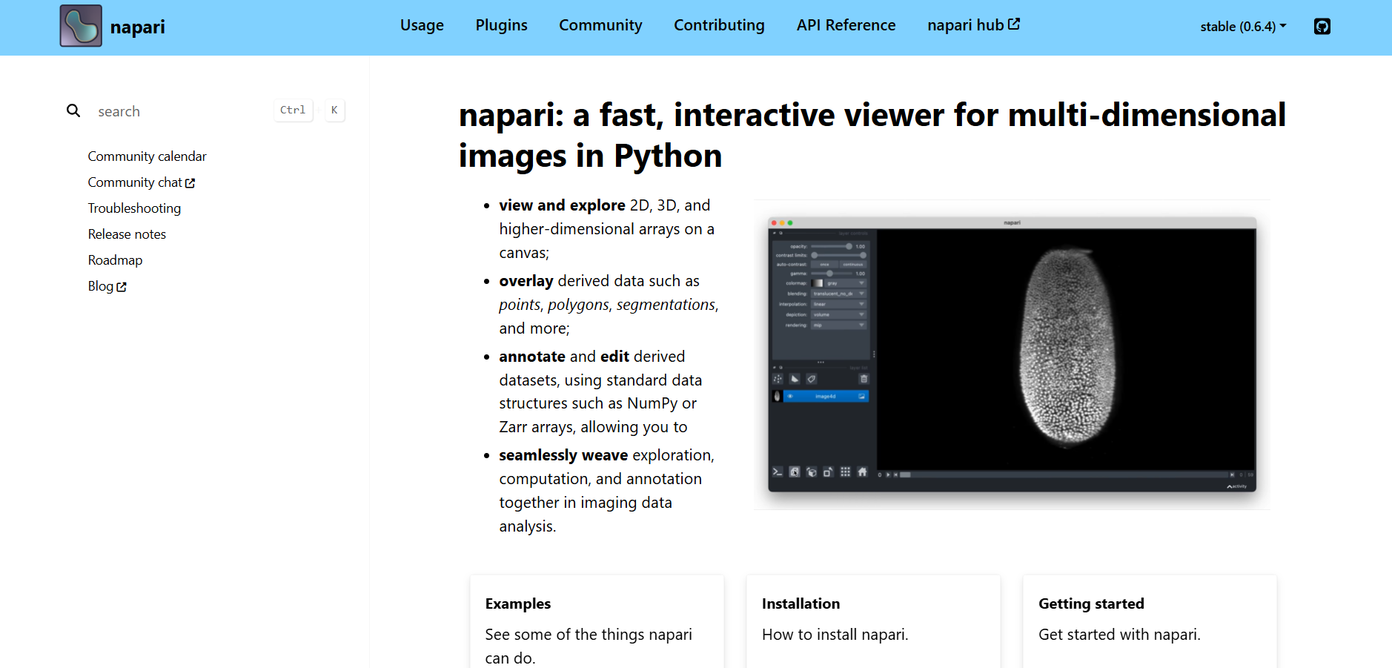
NAPARI
LINK:
https://napari.org/stable/

Slide 4
OUTPUT
Topographic map
DATASETS
Size
Number of lysosomes

Slide 5
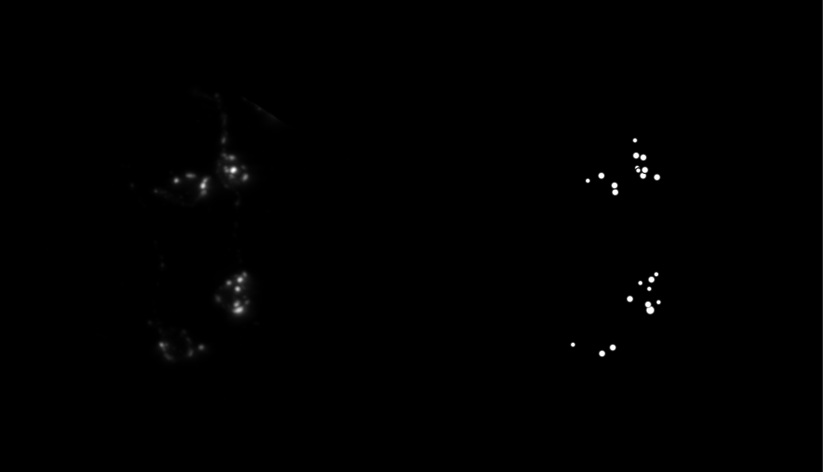
Topographic map

Slide 6


Topographic map

Slide 7
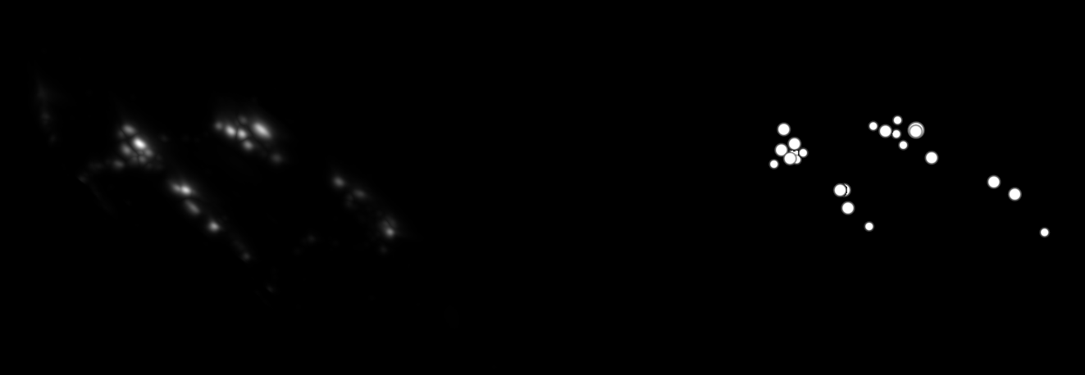
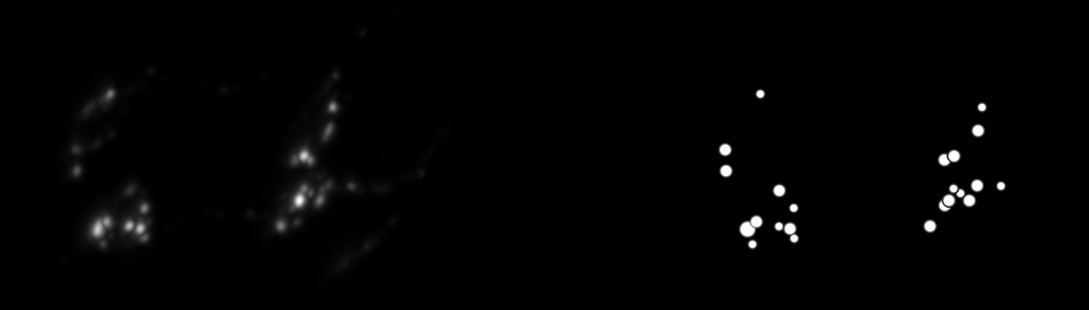
Topographic map

Slide 8
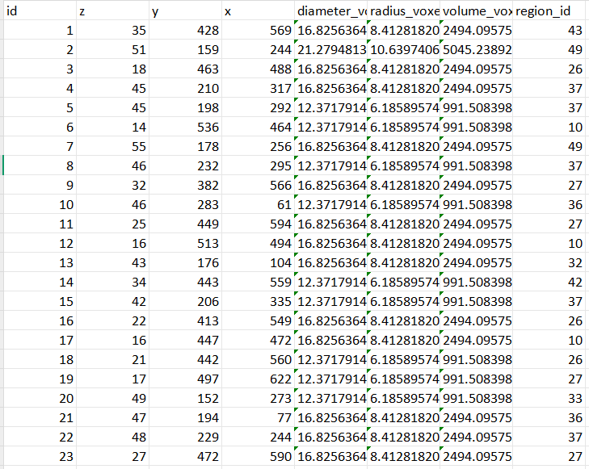
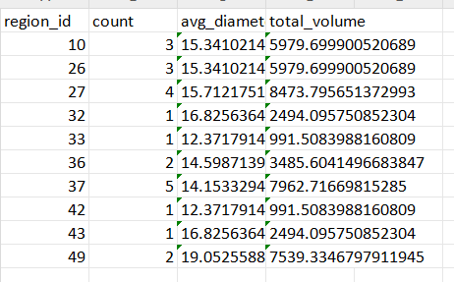
DATASETS
NUMBER OF LYSOSOMES
23

Slide 9
Questions?

